Slide 1

Neural CRNs
A Learning Implementation in
Chemical Reaction Networks
Rajiv Nagipogu
Reif Lab
Duke Computer Science

Slide 2

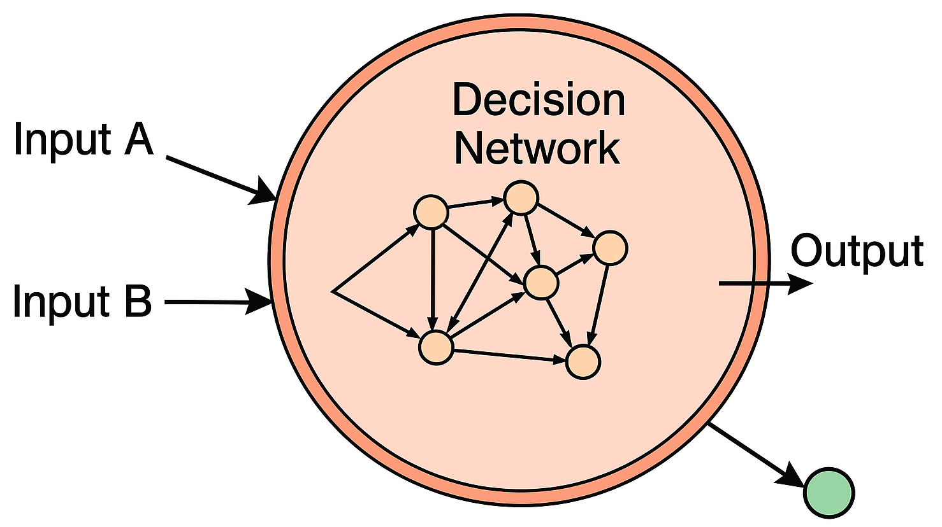
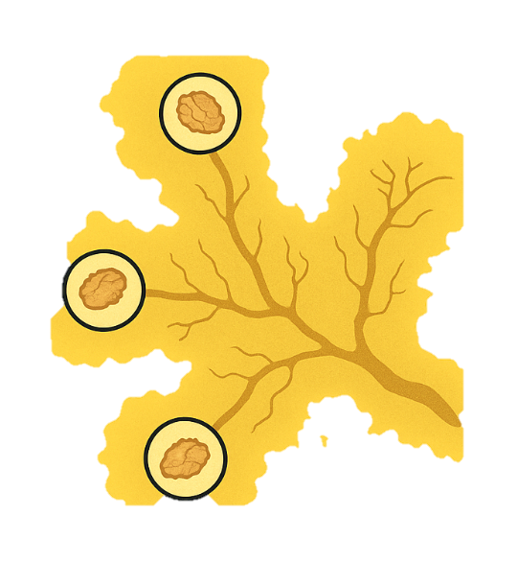
Towards adaptive biochemical circuits in situ
Learning and adaptation are inherent in biological systems
Paramecia could be classically conditioned
Adaptive behavior in synthetic circuits:
CS
flees
→ To monitor dynamic biochemical environments
+
US
→ Decision-making in artifical cells
Training
Later on…
→ Adaptive therapeutics, diagnostics
Slime molds display intelligent foraging behaviors
biomarkers
Therapeutic
molecule
…
Notes:
30 sec

Slide 3
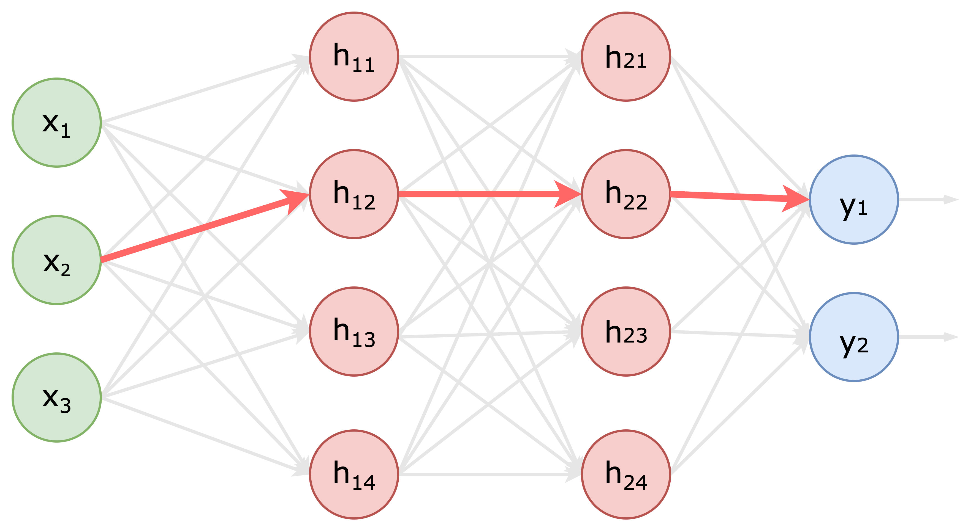
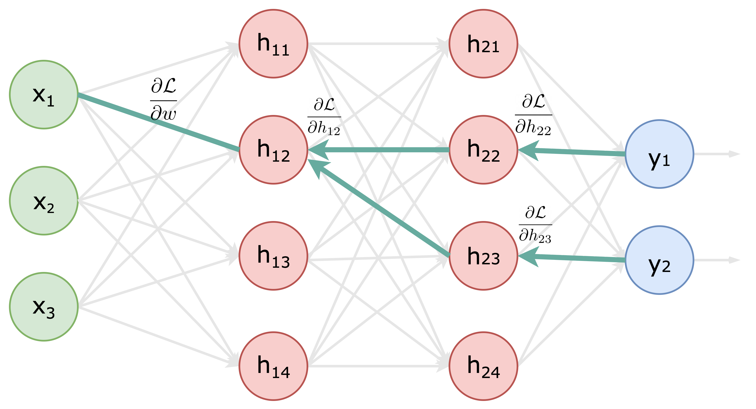
Learning is typically associated with neural networks
Compact representations and gradient descent-based learning protocols
Feedforward phase
Feedback phase
Learning through adjoint state backpropagation
Using chain rule of partial differentiation
Notes:
30 sec

Slide 4
Chemical implementations of neural networks
Analog implementation of
Neural networks
layer transformation
(Anderson et al. 2020)
Enzymatic
Convolutional network
XOR decision boundary
(Xiong et al. 2022)
Perceptron using
Strand displacement gates
(Lakin & Stefanovic 2016)
Tanh-activated network
Weight-perturbation algorithm
(Arredondo et al.2020)
Real Perceptrons
(Banda et al. 2014)
Feedforward network
as an XOR system
(Blount et al. 2017)
ReLU-activated using
rate-indep. CRNs
(Vasic et al. 2020)
Binary Perceptron
(Hjelmfelt et al. 1993)
Binary Perceptrons
(Banda et al. 2013)
…
1993
2013
2014
2016
2017
2020
2022
Binary Perceptrons
Real-valued Perceptrons
Feedforward networks w/ nonlinear activations
Composing chemical implementations of constituent algebraic computations
Requires adding multiple ‘stop-and-play’ mechanisms
On reaction network implementations of neural networks
Notes:
45 sec

Slide 5








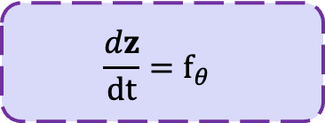

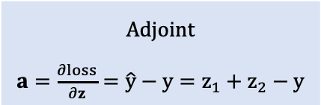


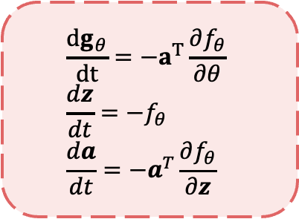









Learning in Neural ODEs: The adjoint sensitivity method
$$f_{θ}$$
Integrated in forward time
$$t=0$$
$$t=T$$
Unit
perceptron
Neural ODE
forward
$$\frac{dz}{dt}=f_{θ}$$
$$x$$
$$=$$
$$z$$
$$z$$
$$∑$$
$$\hat{y}$$
$$y$$
P
loss
$$loss=\frac{1}{2}{\left(\hat{y}−y\right)}^{2}$$
$$=$$
$$\frac{{dg}_{θ}}{dt}=−a^{T}\frac{∂f_{θ}}{∂θ} \\ \frac{dz}{dt}=−f_{θ} \\ \frac{da}{dt}=−a^{T}\frac{∂f_{θ}}{∂z}$$
$$θ=θ−ηg_{θ}$$
$$Adjoint$$
$a=\frac{∂loss}{∂z}=\hat{y}−y=z_{1}+z_{2}−y$
$${ g}_{θ}$$
Neural ODE
backward
$$z$$
$$a$$
$$a$$
$$z$$
$${ g}_{θ}$$
0
Integrated backward in time
(Invert sign parities when converting to CRNs)
$$t=0$$
$$t=T$$
Neural Ordinary Differential Equations
Notes:
30 seconds

Slide 6


Supervised learning pipeline in Neural CRNs
N1: State evolution
N2: Adjoint creation
N3: Gradient evolution
N4: Parameter update
$$\hat{Y}$$
output
+
Z
=
N1
N2
N3
Z
Z
A
G
G
-
$$Y$$
X
P
target
0
N4
input
Parameters
Notes:
1 min 30 sec

Slide 7

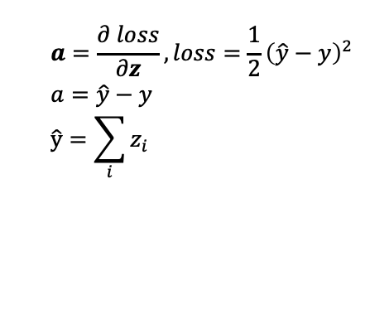
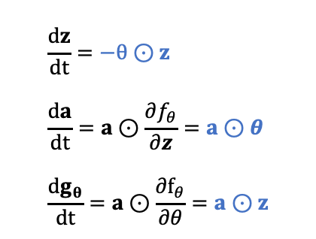
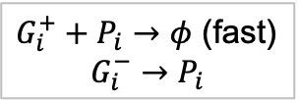
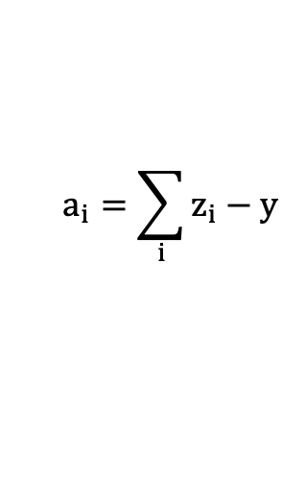
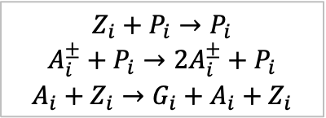
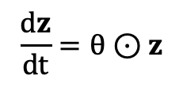
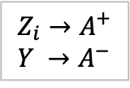

An example construction: $f_{θ}=θ⊙z$
N1
N2
N3
N4
State evolution
Adjoint creation
Gradient evolution
Parameter update
$$\frac{dz}{dt}=−θ⊙z \\ \frac{da}{dt}=a⊙\frac{∂f_{θ}}{∂z}=a⊙θ \\ \frac{dg_{θ}}{dt}=a⊙\frac{∂f_{θ}}{∂θ}=a⊙z$$
$$a=\frac{∂ loss}{∂z}, loss=\frac{1}{2}{\left(\hat{y}−y\right)}^{2} \\ a=\hat{y}−y \\ \hat{y}=\sum_{i}{z_{i}}$$
$$\frac{dz}{dt}=θ⊙z$$
$$a_{i}=\sum_{i}{z_{i}−y}$$
(sign parities inverted)
$$θ_{i}=θ_{i}−g_{θ}$$
$$Z_{i}+P_{i}→P_{i}$$
$$A_{i}^{±}+P_{i}→2A_{i}^{±}+P_{i}$$
$$A_{i}+Z_{i}→G_{i}+A_{i}+Z_{i}$$
$G_{i}^{+}+P_{i}→φ$ (fast)
$$G_{i}^{−}→P_{i}$$
$$P_{i}+Z_{i} →Z_{i}+Z_{i}+P_{i}$$
$$Z_{i}→A^{+} \\ Y →A^{−}$$
Analog
Discrete algebraic
Analog
Discrete algebraic
Bimolecular
Unimolecular
Bimolecular
Unimolecular
(end-point rxn.)
(end-point rxn.)
Notes:
1 min 30 sec

Slide 8



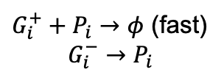




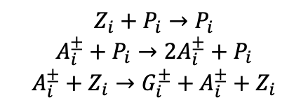
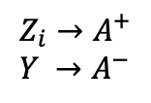




Supervised learning pipeline within a two-phase clock system
N1
N2
N3
N4
State evolution
Adjoint creation
Gradient evolution
Parameter update
$$Z_{i}+P_{i}→P_{i}$$
$$A_{i}^{±}+P_{i}→2A_{i}^{±}+P_{i}$$
$$A_{i}^{±}+Z_{i}→G_{i}^{±}+A_{i}^{±}+Z_{i}$$
$$P_{i}+Z_{i} →Z_{i}+Z_{i}+P_{i}$$
$$Z_{i}→A^{+} \\ Y →A^{−}$$
$G_{i}^{+}+P_{i}→φ$ (fast)
$$G_{i}^{−}→P_{i}$$
Analog
Discrete algebraic
Analog
Discrete algebraic
Bimolecular
Unimolecular
Bimolecular
Unimolecular
$$T$$
$$ε$$
N1
N2
$$T$$
$$ε$$
N3
Enable time-scale separation between unimolecular and bimolecular reactions
N4
$$t=0$$
$$t=T$$
$$t=T+ε$$
$$t=2T$$
$$t=2T$$
$$t=2T+ε$$
Notes:
45 sec

Slide 9
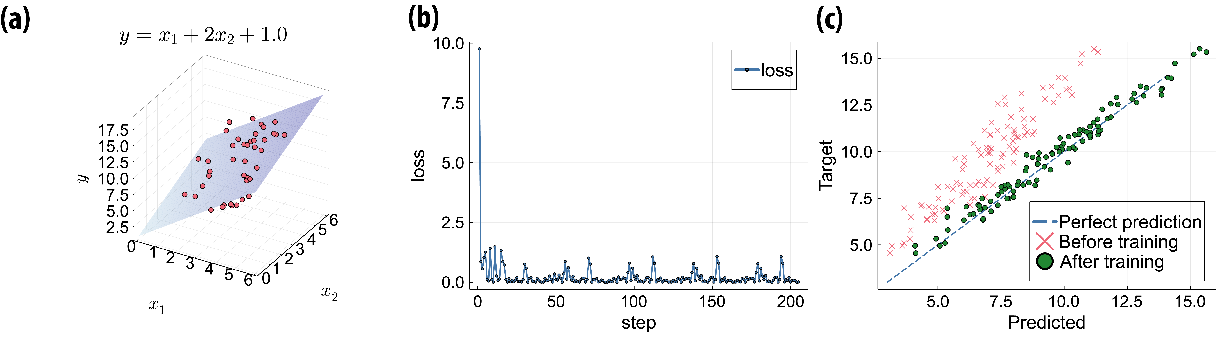
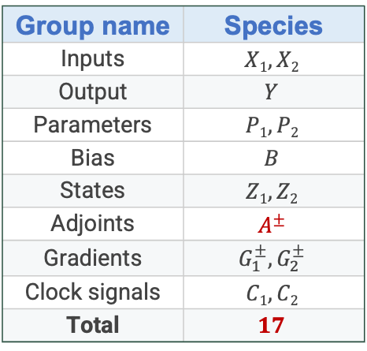


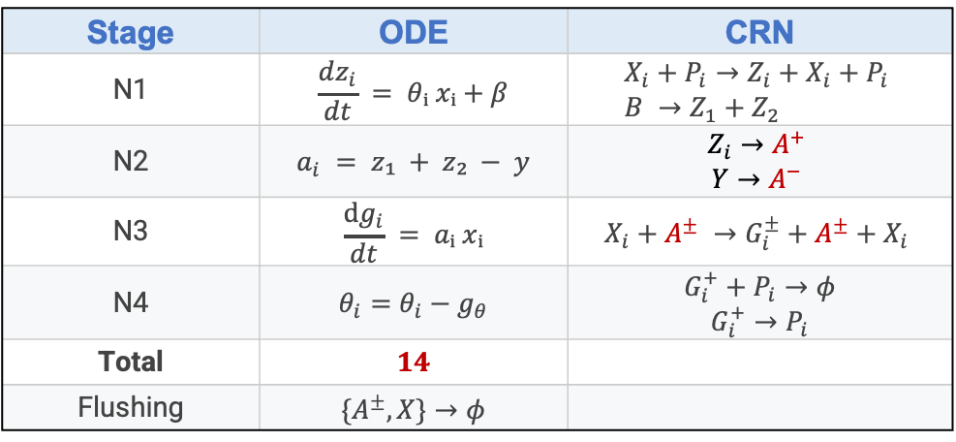
A circuit for linear regression
$f_{θ}=θ⊙x+β θ∈R_{>0}^{2} and x∈R_{>0}^{2}, β∈R_{>0}$
Group name | Species
Inputs | $$X1, X2$$
Output | $$Y$$
Parameters | $$P1, P2$$
Bias | $$B$$
States | $$Z1, Z2$$
Adjoints | $$A^{±}$$
Gradients | $$G_{1}^{±}, G_{2}^{±}$$
Clock signals | $$C1, C2$$
Total | $$17$$
Stage | ODE | CRN
N1 | $$\frac{dz_{i}}{dt} = θᵢ xᵢ+β$$ | $$X_{i}+P_{i}→Z_{i}+X_{i}+P_{i} \\ B →Z_{1}+Z_{2}$$
N2 | $$a_{i} = z₁ + z₂ − y$$ | $$Z_{i}→A^{+}$$ $$Y→A^{−}$$
N3 | $$\frac{dg_{i}}{dt} = aᵢ xᵢ$$ | $$X_{i}+A^{±} →G_{i}^{±}+A^{±}+X_{i}$$
N4 | $$θ_{i}=θ_{i}−g_{θ}$$ | $$G_{i}^{+}+P_{i}→φ$$ $$G_{i}^{+}→P_{i}$$
Total | $$14$$
Flushing | $${\{A}^{±}, X\}→φ$$
$$y=x_{1}+2 x_{2}+1$$
Notes:
45 sec

Slide 10
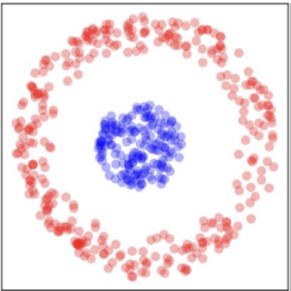
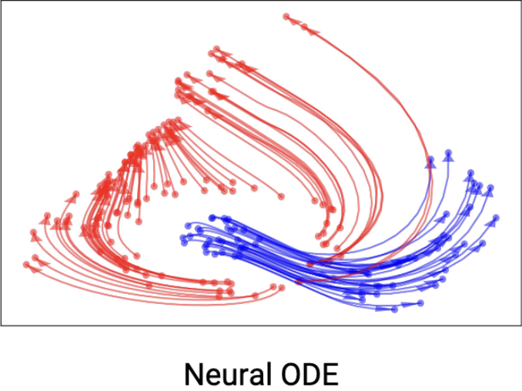
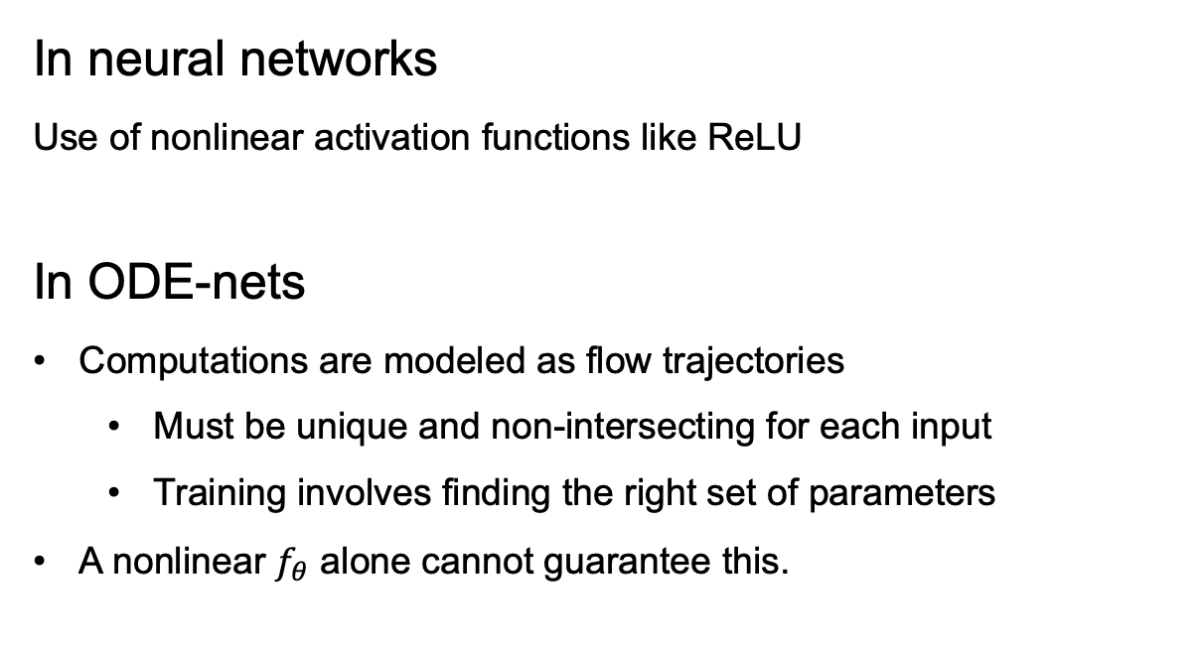
Nonlinear modeling in Neural CRNs
In neural networks
Use of nonlinear activation functions like ReLU
In ODE-nets
Computations are modeled as flow trajectories
  Must be unique and non-intersecting for each input
  Training involves finding the right set of parameters
A nonlinear $f_{θ}$ alone cannot guarantee this.
Augmented Neural ODEs
Notes:
1 min

Slide 11
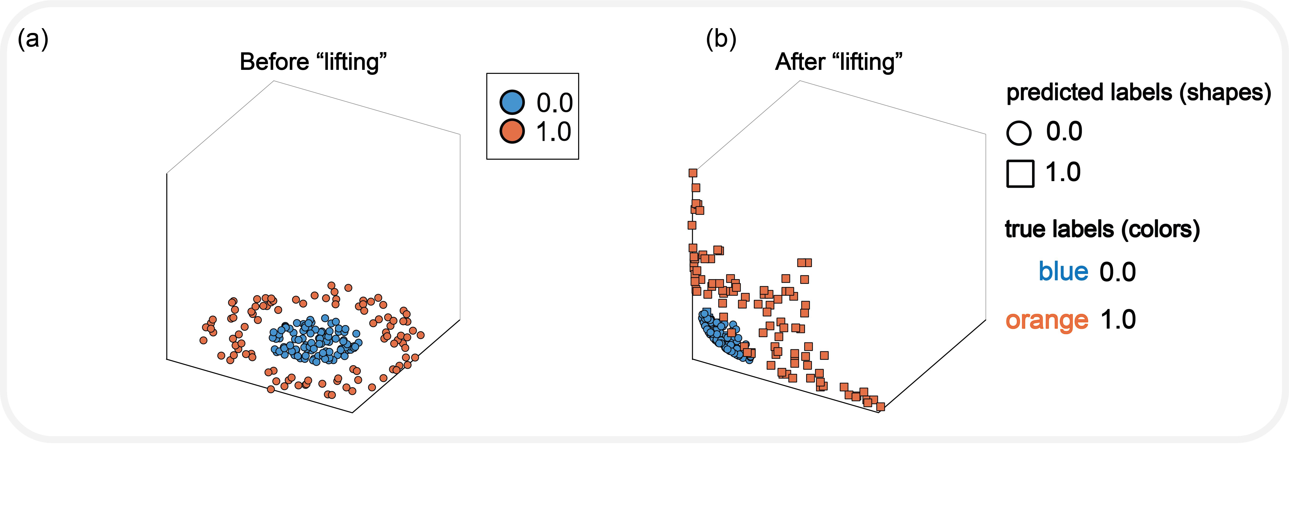
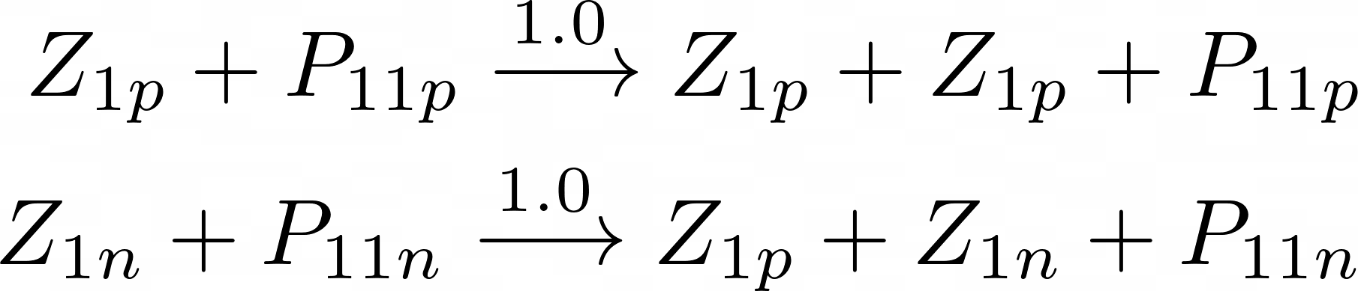
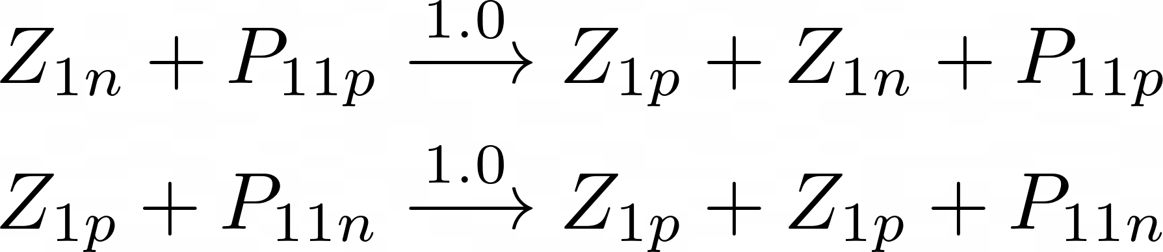
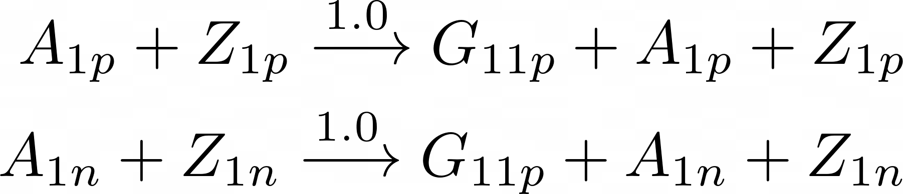



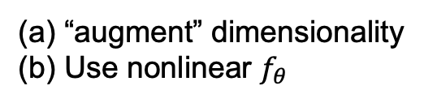




Implicit lifting and nonlinear Neural CRNs
Incorporate the Implicit lifting trick
$$f_{θ}\left(x, z\right)=θ⊙x −αz⊙z$$
(bimolecular)
Neural CRN
$$Z_{1}$$
$$Z_{1}$$
$$W_{1}$$
“augment” dimensionality
Use nonlinear $f_{θ}$
$$Z_{2}$$
$$Z_{2}$$
Ŷ
$$W_{2}$$
p
p
Padded dimension
Learned XOR decision boundary
Notes:
45 sec

Slide 12




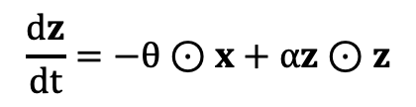

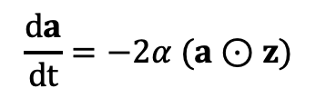

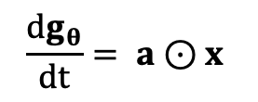

First-order gradient approximation for nonlinear modeling
$$f_{θ}\left(x, z\right)=θ⊙x −αz⊙z$$
Let’s assume that adjoint $a$ is kept constant
$$\frac{dg_{θ}}{dt}= a⊙x$$
$$A^{±}+X →G^{±}+A+X$$
Feedback phase
$$\frac{dg_{θ}}{dt}= a⊙x$$
$$g_{θ}=Ta⊙x=T\left(\hat{y} −y\right)x_{i}$$
Recall $a=\hat{y}−y$
$$\frac{da}{dt}=−2α (a⊙z)$$
Similar to perceptron learning
$$Δw=LR∗\left(\hat{y}−y\right)x$$
$$\frac{dz}{dt}=−θ⊙x+αz⊙z$$
XOR Task
XOR Inference
Notes:
1 min

Slide 13
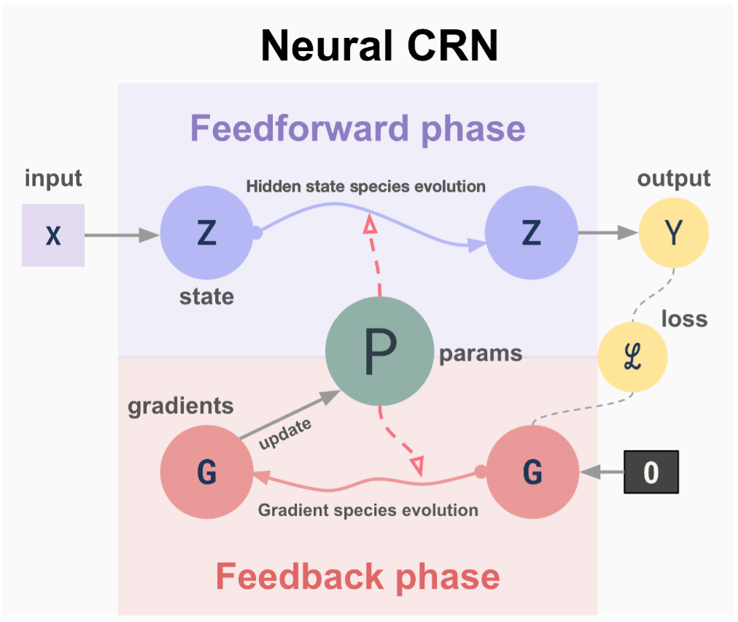
Summary
Neural CRNs: A supervised learning algorithm where chemical reactions behave as end-to-end computational units
The whole pipeline can be executed within two clock phases
Nonlinear modeling using unimolecular and bimolecular reactions
Reduction in circuit size through linear approximation of gradients
A minimal linear circuit:14 species and 13 abstract reactions
Possibility of Asynchronous execution (some stages)
…many more
Thank you!
Notes:
30 sec

Slide 14
Next steps…
A simple strand displacement implementation of forward and backpropagation steps
  Using frameworks congenial to “catalytic” reactions
Integrating synergistically with a chemical delay-line
to implement a temporal information processing system
Revamping the system to be more aligned to biomolecular computation

Slide 15
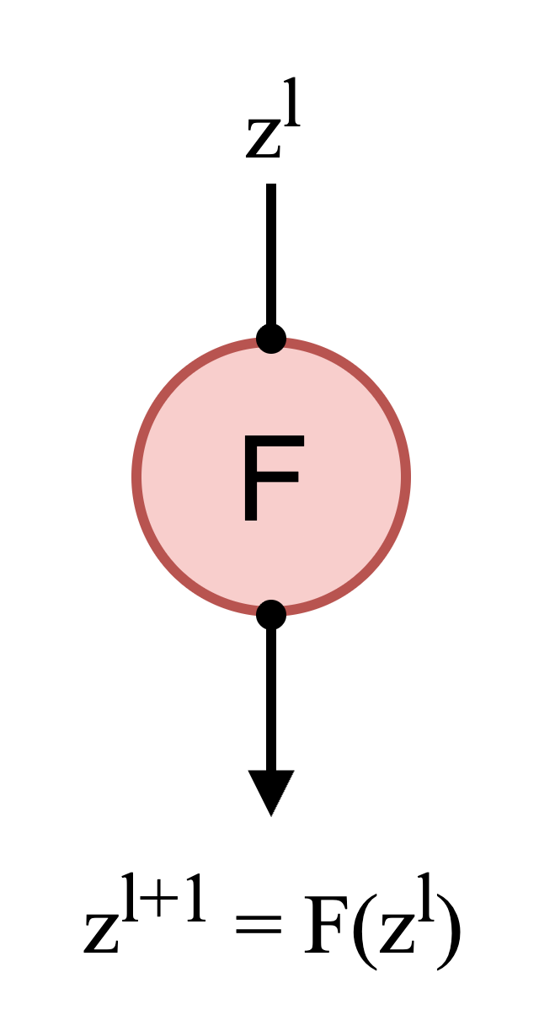
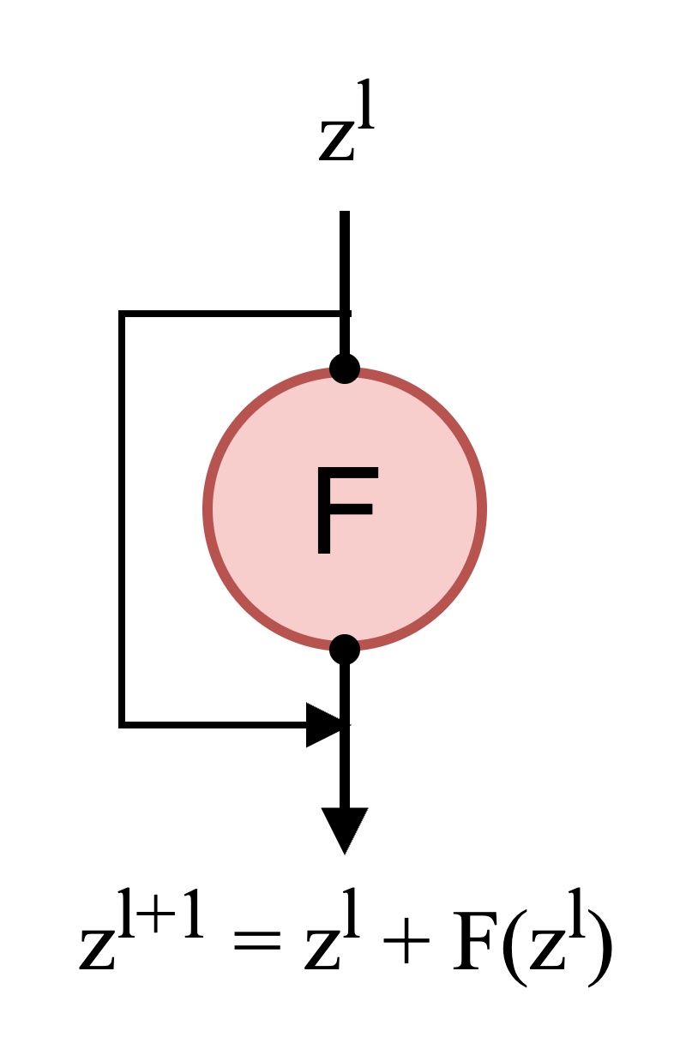
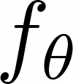
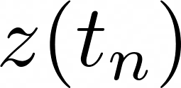
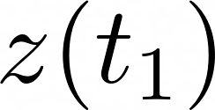
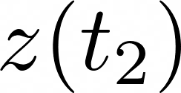
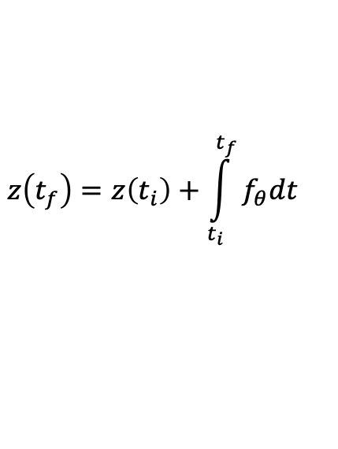
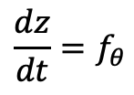
ODE-based neural networks
FFNN
ResNet
Neural ODE
“residual”
connection
.
.
continuous-time
approximation
.
$$\frac{dz}{dt}=f_{θ}$$
$$z\left(t_{f}\right)=z\left(t_{i}\right)+\int_{t_{i}}^{t_{f}}{f_{θ}dt}$$
Neural Ordinary Differential Equations

Slide 16
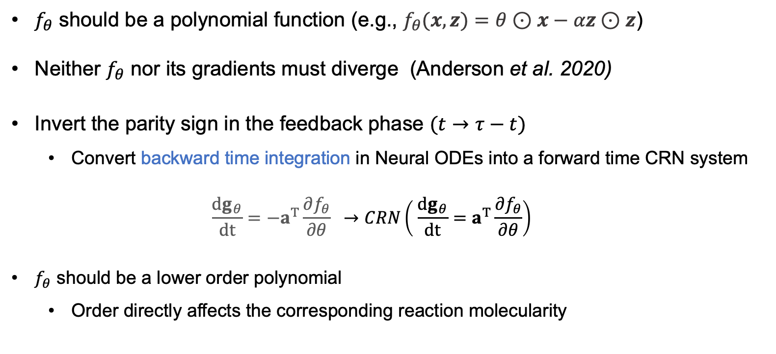
From Neural ODEs to Neural CRNs
$f_{θ}$ should be a polynomial function (e.g., $f_{θ}(x, z)=θ⊙x−αz⊙z$)
Neither $f_{θ}$ nor its gradients must diverge (Anderson et al. 2020)
Invert the parity sign in the feedback phase $(t→τ−t)$
  Convert backward time integration in Neural ODEs into a forward time CRN system
  $$\frac{{dg}_{θ}}{dt}=−a^{T}\frac{∂f_{θ}}{∂θ} →CRN\left( \frac{{dg}_{θ}}{dt}=a^{T}\frac{∂f_{θ}}{∂θ}\right)$$
$f_{θ}$ should be a lower order polynomial
  Order directly affects the corresponding reaction molecularity
Notes:
45 sec

